Slide 1

Introduce Azure to your environment
Sarah Lean
Senior Cloud Advocate
Microsoft
@Techielass
www.techielass.com

Slide 2



Who am I?
Senior Cloud Advocate @ Microsoft
Blog at www.techielass.com
@Techielass
Founder of the Glasgow Azure User Group
STEM Ambassador
14+ years in the IT industry
IT Pro

Slide 3
Software and hardware refresh
Security threats
Urgent capacity needs
Compliance
Quickly integrate acquisitions
Application innovation
Migration drivers
Software end of support
Datacenter contracts expiry

Slide 4

Notes:
In this presentation we’re going to follow the story of Tailwind Traders, a fictional retail company that are looking to introduce Azure into their environment to help solve some capacity issues they have and also introduce some new capabilities into their infrastructure.

Slide 5

THE WEBSITE
Notes:
One of the first things that they want to tackle is their website.
There current website isn’t coping very well with the increased traffic they are seeing. So they want to start to move their websites to Azure.
They are looking to do that by slowly introducing new website servers.

Slide 6

Traffic Manager
Traffic Manager
DNS-based load balancer
Supports external, non-Azure endpoints
Hybrid cloud and on-premises deployments
Public facing endpoint
Routing methods
Priority, weighted, performance, geography, subnet, multi-value
Microsoft Azure | @Techielass
Notes:
DNS load balancer
So it can take a domain such as www.contoso.com resolve that and then point it to your resources that might be spread out within different Azure regions or even on premises
It will then look at where I am, the person trying to access www.contoso.com from and send me to the closest one, the one with the least latency
OR it can do priority or weighted or the other routing methods you might want
At that point Traffic manager kind of stops the conversation and the connection is between you and the end point.
Moving from on prem to the cloud, you can have those end points as well, It doesn’t care where the end points are.

Slide 7
How does it work
www.tailwindtraders.com
CNAME
tailwind.trafficmanager.net
Load-balancing and
Endpoint monitoring
Cloud service
Azure web site
Non-Azure
Endpoints
Microsoft Azure | @Techielass
Notes:
Set the context…
Load balance incoming traffic across multiple Azure services to provide your applications high performance
Automatically fail over between deployments, for high availability
Manage traffic across Cloud and on-premises endpoints for hybrid applications and Cloud migration
Easily add/remove deployments from active use, allowing seamless upgrades
Build sophisticed traffic-routing rules for large and complex applications

Slide 8


External Endpoints
Traffic Manager supports endpoints outside of Azure
Simply specify an arbitrary DNS name, e.g. mysite.tailwindtraders.com
Works with all traffic-routing methods
Enables a variety of ‘hybrid’ scenarios
Smooth migration from on-premises to Cloud
Geo-expansion of existing applications
Burst-to-Cloud
Failover-to-Cloud
Traffic Manager
Azure Endpoint
On-Premises Endpoint
Microsoft Azure | @Techielass

Slide 9
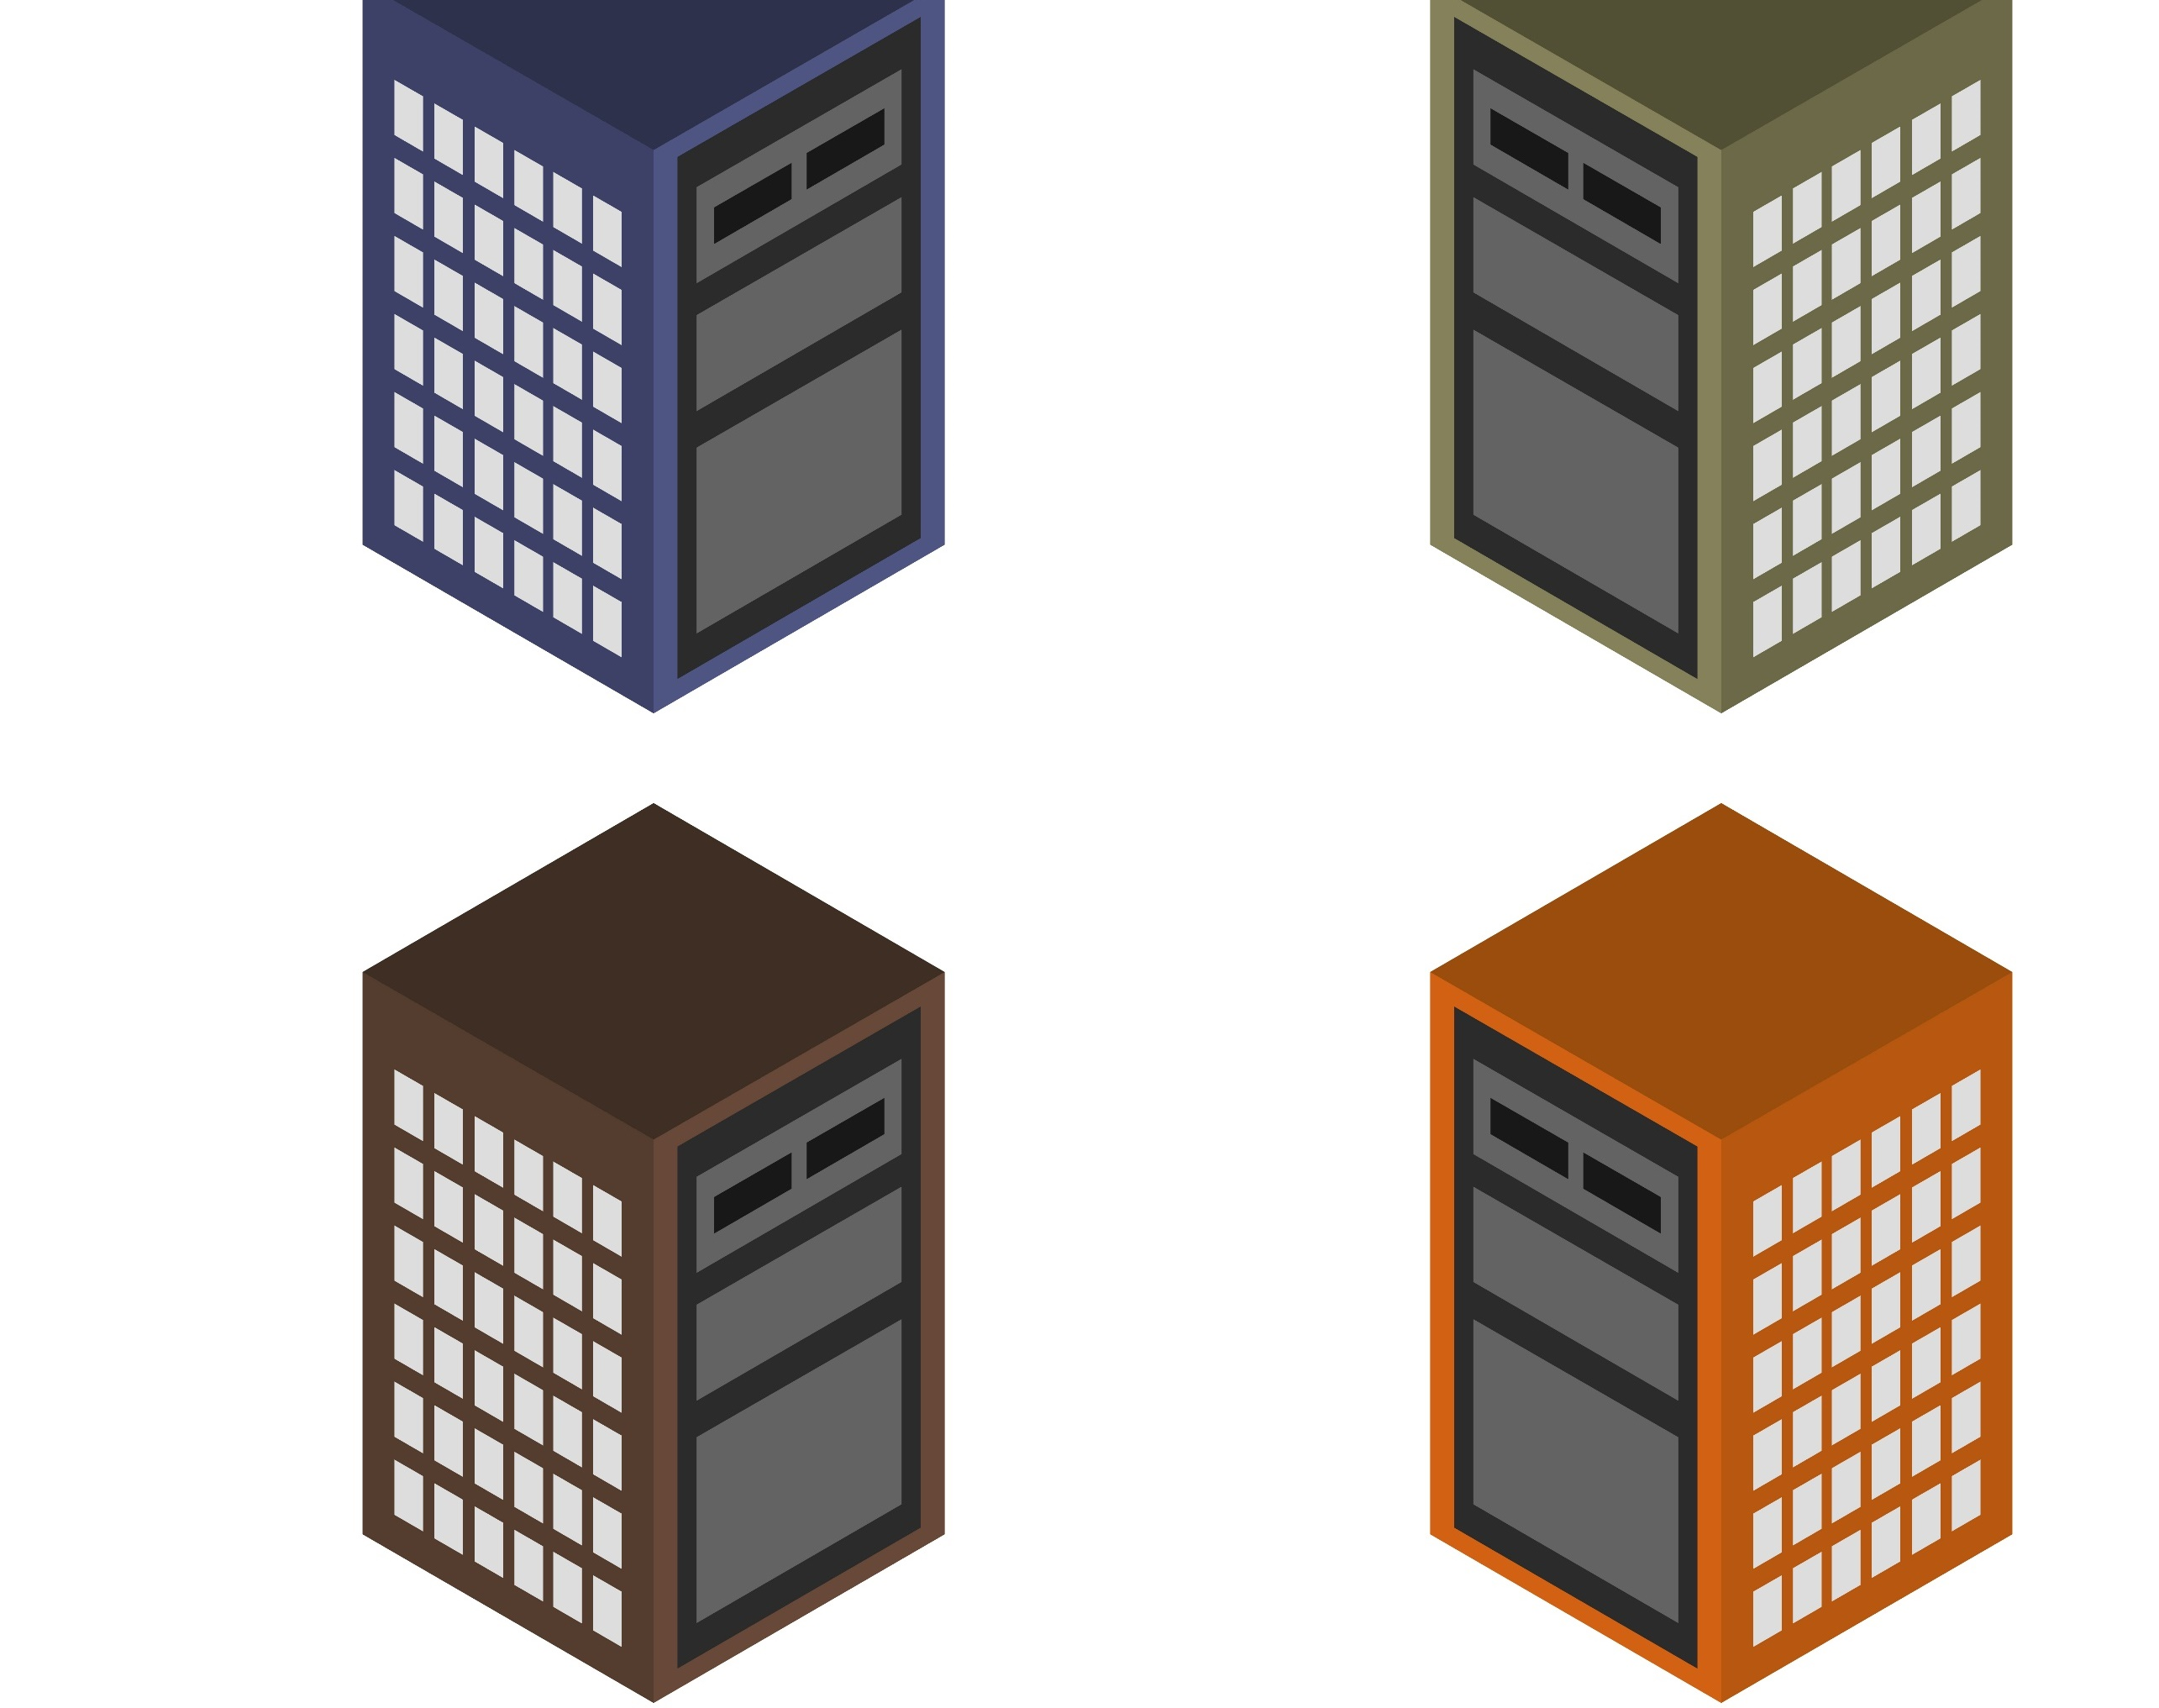
Server Management

Slide 10

Windows Admin Center
Modern Server Management
Simply Server Management
Operate Hybrid Seamlessly

Slide 11
Server management reimagined
Manage systems, including multiple versions of Windows Server
Bolster network security
Keep local files in sync with the cloud
Apply updates
Streamline everyday tasks on premises
Add hybrid capabilities
Monitor server performance
Back up servers
Protect servers intelligently
Predict capacity needs
Resolve server issues
Maximize performance, availability
Microsoft Azure | @Techielass
Notes:
Streamline what you do every day: Simplify server administration with streamlined server management tools. Check the health of your servers, troubleshoot, and perform basic management tasks remotely from a web browser.
Connect easily with Azure to extend your environment. Integrate your on-premises servers with Azure in just a few clicks. Leverage Azure for monitoring, storage, backup, and disaster recovery in the cloud.

Slide 12




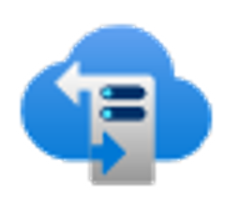



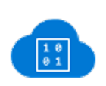





Extend on-premises into Azure
Centrally manage from Azure
Business continuity & disaster recovery
Secure
Monitor
Update
Azure Site Recovery
Azure Backup
Storage Replica
Azure Security Center
Azure Monitor
Azure Update Management
Extend on-premises capacity
Storage
Azure File Sync
Storage Migration Service
Compute
Cloud Witness
Create Azure VM
Azure Arc for Servers
Azure Policy
Networking
Azure Network Adapter
Azure Extend Network
Microsoft Azure | @Techielass

Slide 13



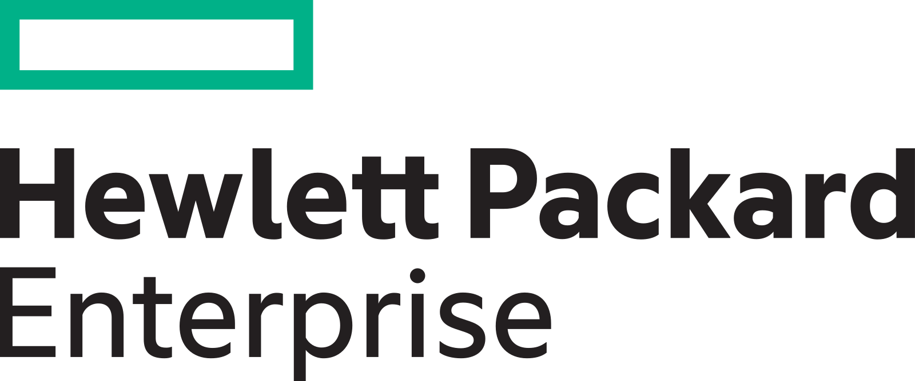

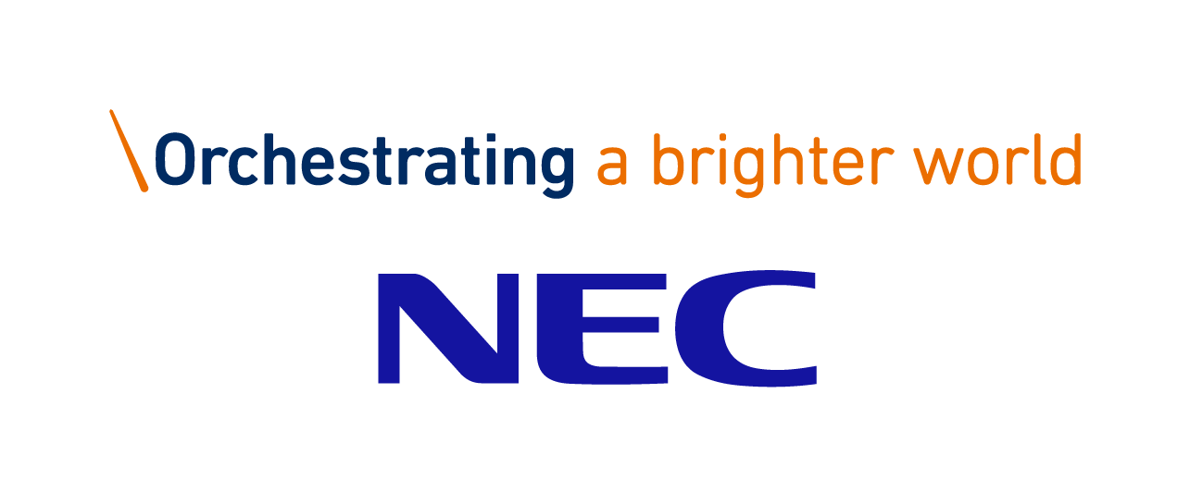


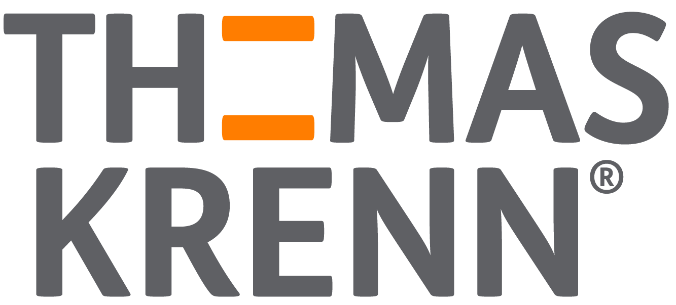
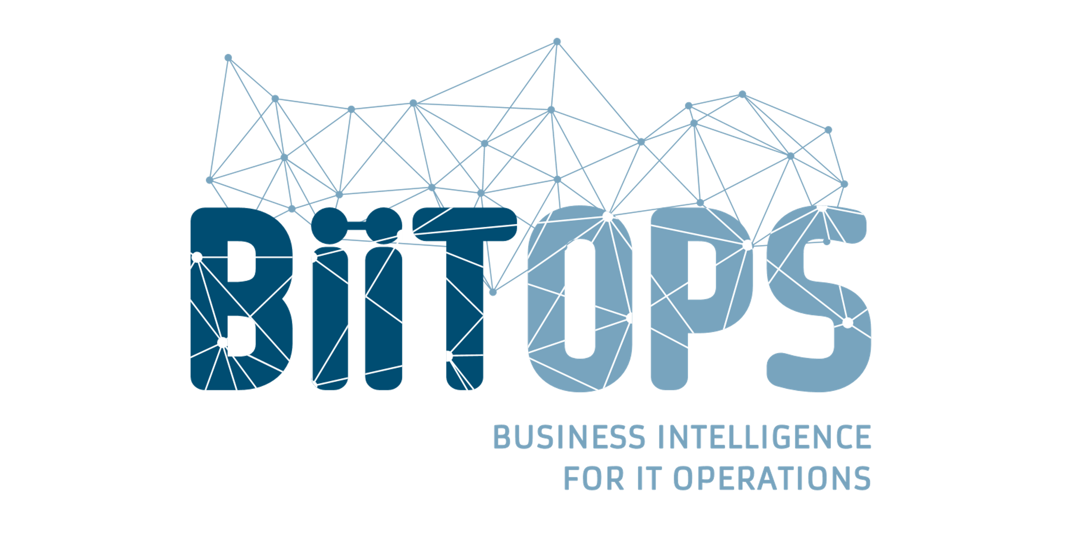
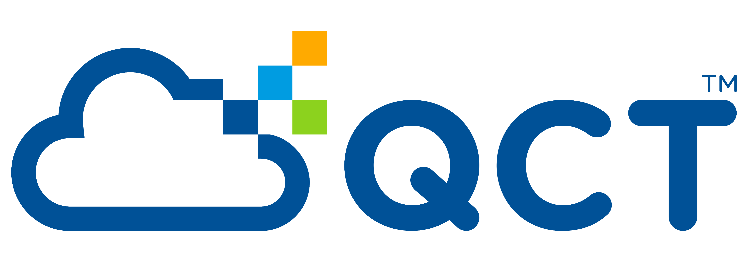
Windows Admin Center Partners
Microsoft Azure | @Techielass

Slide 14
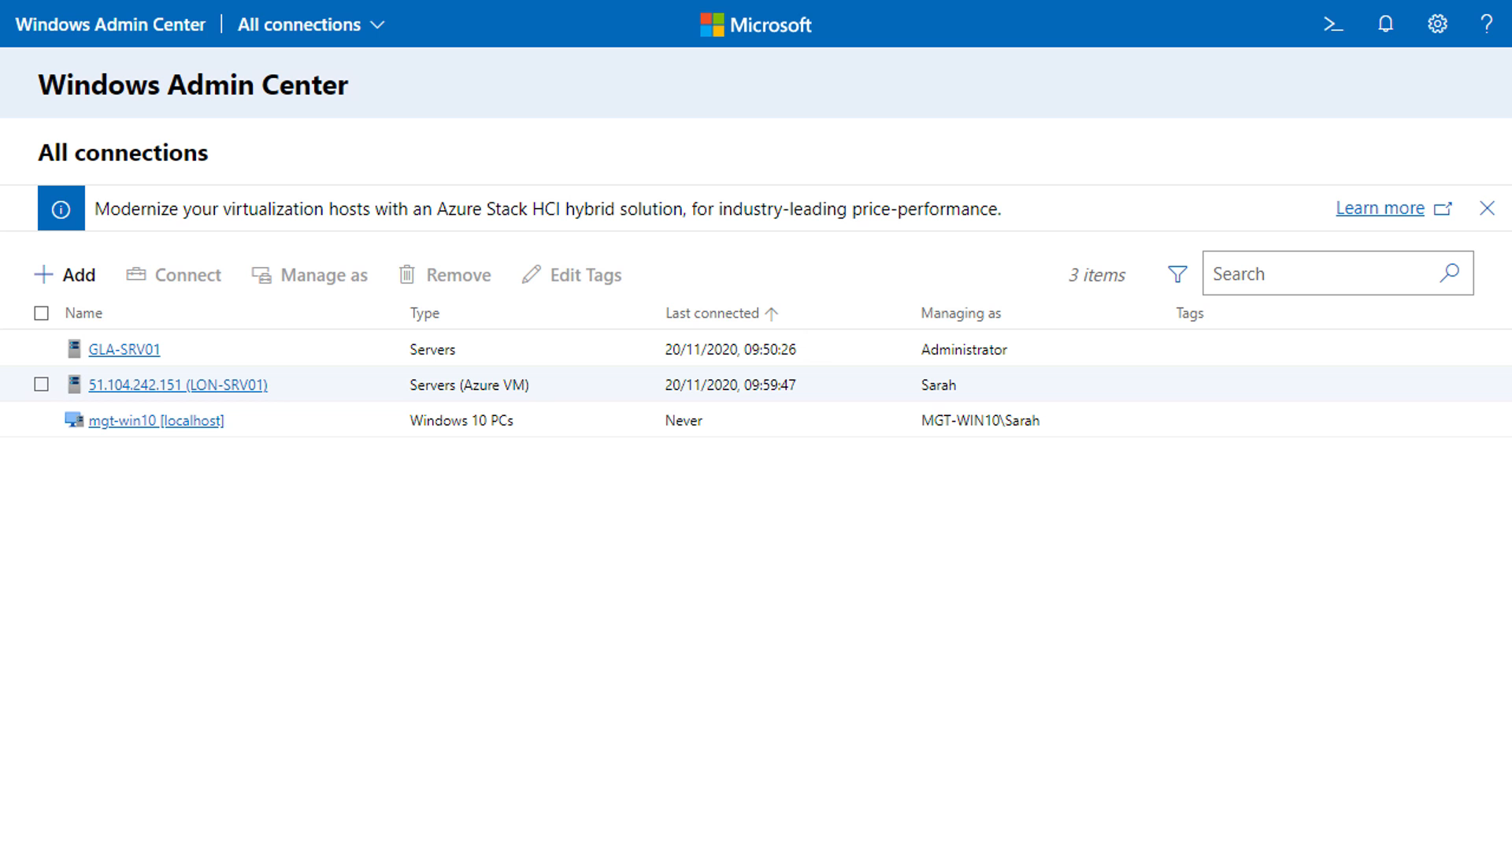

Slide 15

Compliance & Consistency
Notes:
How does Tailwind Traders makes sure servers across Azure, on-premises and other cloud providers are compliant, configured and managed in a single control pane?

Slide 16
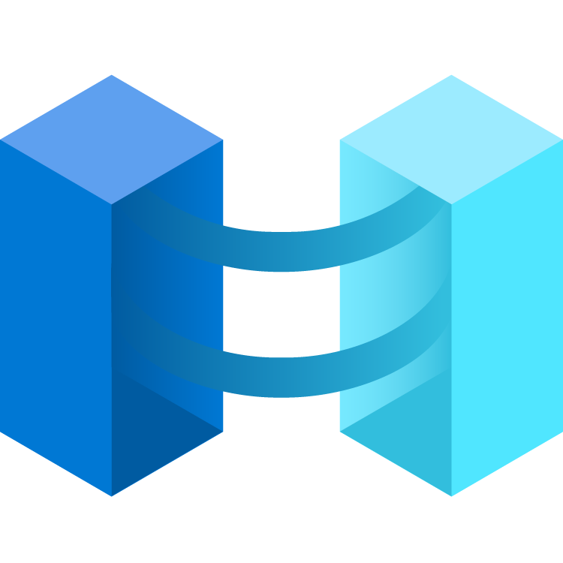


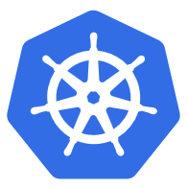

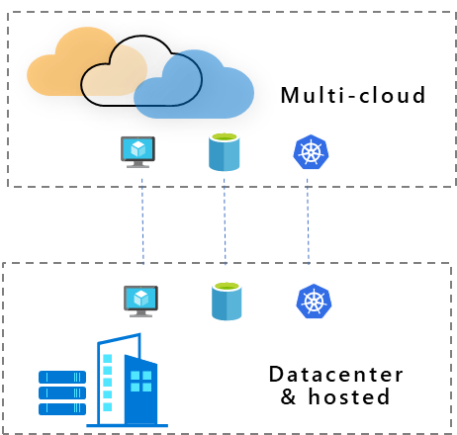

Single control plane with Azure Arc
Manage on-premises, multi-cloud and edge environments
Multi-cloud
Datacenter & hosted
Organize and govern across environments
At-scale Kubernetes app management
Run data services anywhere
Notes:
Many of our customers face a growing sprawl of resources spread across multiple datacenters, clouds, and edge locations. Our customers tell us that they are looking for a way to inventory, organize, and govern their IT resources wherever they are, from a central place. At Microsoft Ignite, we announced a major step forward towards this goal with the introduction of Azure Arc. Azure Arc simplifies complex and distributed environments by extending Azure management across clouds datacenters and edge locations as well as enabling the deployment of Azure Services to any infrastructure.
Extend Azure management across your environments
Get Kubernetes clusters and servers that are sprawling across clouds, datacenters and edge under control by centrally organizing and governing from a single place.
Manage and govern resources at scale with powerful scripting, tools, Azure Portal and API, and Azure Lighthouse
At-scale Kubernetes app management
Deploy and manage Kubernetes applications at scale across environments using DevOps techniques. Ensure that applications are deployed and configured consistently from source control, at scale.
Easily adopt DevOps techniques such as infrastructure as code that Empower developers with self-service and choice of tools complemented by central IT governance and guidance
Implement Azure security anywhere
Deploy and manage data services where you need it for latency or compliance reasons. Always use the most current technology and seamlessly manage and secure your data assets across on-premises, clouds and edge.
Access unique Azure security capabilities such as Azure Threat Detection
Centrally manage access and security policies for resources with Role Based Access Control
Enforce compliance and simplify audit reporting

Slide 17
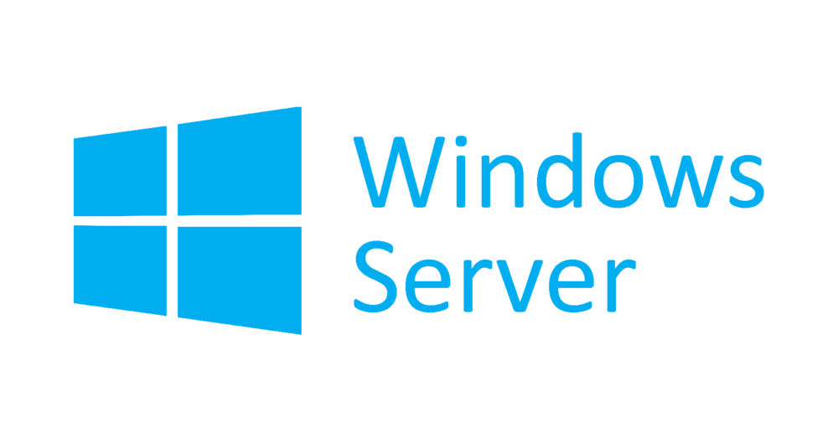




Azure Arc enabled servers Azure Arc enabled servers are auto-enrolled with additional Azure services
Additional services
Azure Policy
Azure Defender
Azure Sentinel
Azure Monitor
Change and inventory tracking
Update management
Azure Security Center
AWS Linux 2
Just turn them on when you want to use them
Notes:
Remember, I talked earlier about how Azure Arc extends Azure management services to your non-Azure VMs? Well, a common question we get is : Which management services can I use with my Arc enabled VMs. As you can see here, we have a variety of Azure management services, all of which can be applied to your Arc enabled machines today.

Slide 18




Azure Arc enabled SQL Server Data management benefits for Azure Arc enabled servers
Flexibility
Management
Governance and Security
VMs and bare-metal servers
On-premises and multi-cloud
Searchable inventory
SQL Assessment service
Azure Policy
Azure Defender
No migration needed for existing SQL Servers
Notes:
Use the Azure Portal to register and track the inventory of your SQL Server instances across on-premises, edge sites, and multi-cloud in a single view.
Use Azure Security Center to produce a comprehensive report of vulnerabilities in SQL Servers and get advanced, real time security alerts for threats to SQL Servers and the OS.
Investigate threats in SQL Servers using Azure Sentinel.
Periodically assess SQL Server environment to receive actionable health guidance.
You can also govern across all your SQL Servers with built-in Azure policies to audit and secure your SQL Server estate.

Slide 19
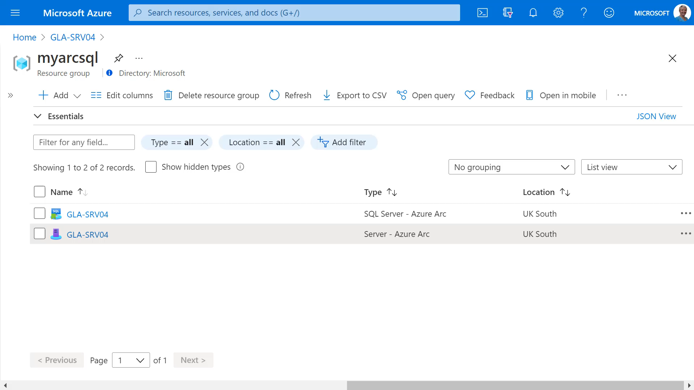

Slide 20

Keeping up to date
Notes:
As we all know ensuring our operating systems are up to date is a big part of reducing the attack surface of our environments. Let’s see the challenges Tailwind Traders face.
TT needs to ensure that physical and virtual machines, both on-prem and IaaS, running Windows or Linux operating systems remain current with software updates
-On Prem you can use Windows Software Update Services, but that only supports Windows, not linux.
Should be possible to determine if physical and virtual machines, both on-prem and IaaS, running Windows or Linux are compliant with current updates
Want to centralize deployment of software updates to on-prem and IaaS Windows and Linux computers
Transition: Azure Update Management will do all of this for you.

Slide 21
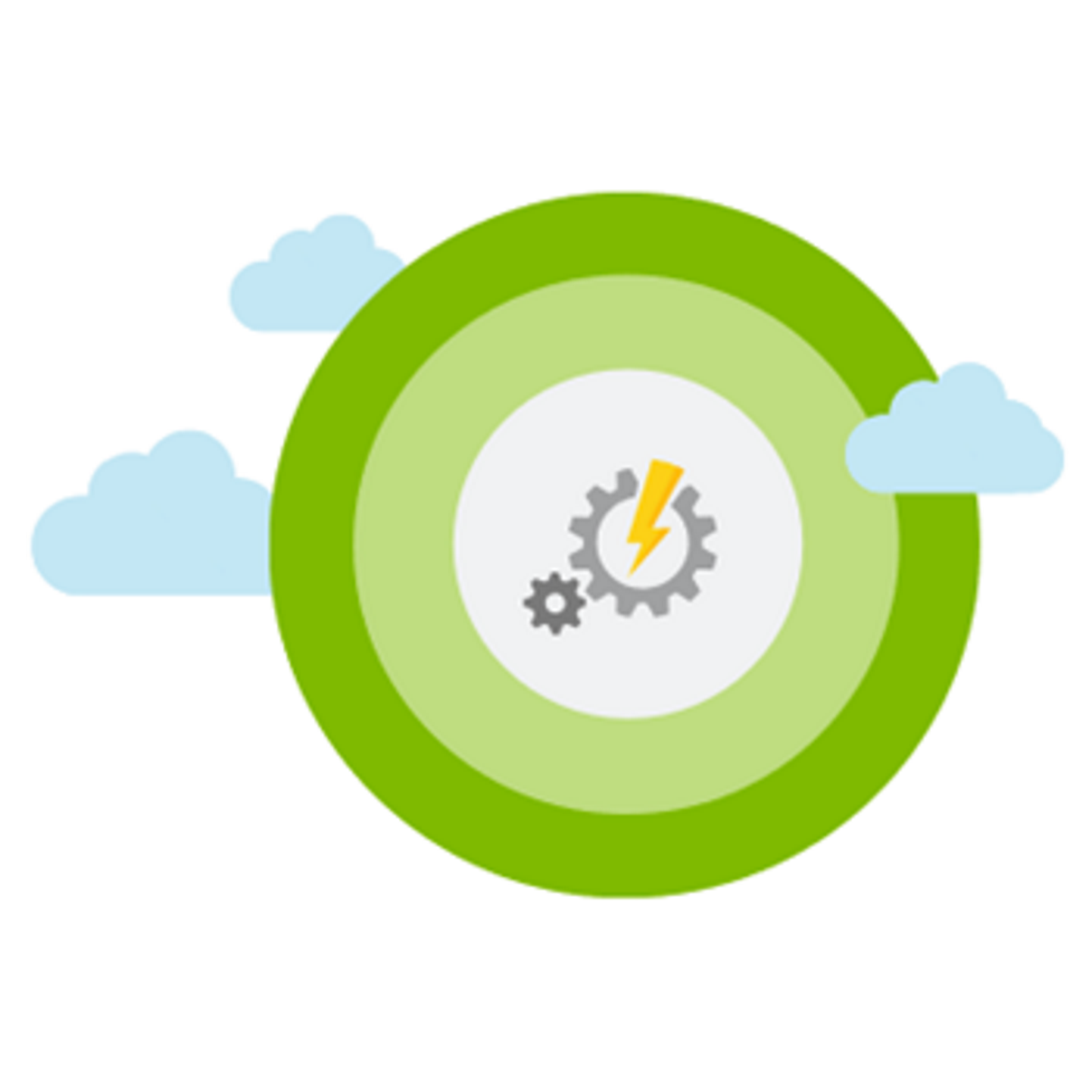
Azure Update Management
Assess update status of servers across your environment
Windows, Linux
Azure, other cloud, on-prem Deploy updates
Custom approval criteria
Single pane of glass
Automated periodic deployments
Verify Compliance
Assess Updates
Deploy Updates
Notes:
Leverages:
Microsoft Monitoring Agent (MMA) for Windows or Linux
PowerShell DSC for Linux
Automation Hybrid Runbook Worker
VMs in multiple subscriptions in the same tenancy
Update available
Linux: 2-3 hours for update to be available after CVE release
Windows: 12-15 hours to be available for assessment after release

Slide 22
Security

Slide 23





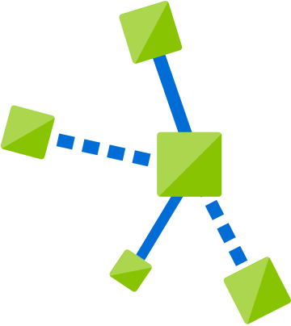

Threat actors leverage a variety of exposures to breach
Exposure
Access
Lateral movements
Actions
Insecure
configuration
Virtual machines
Virtual machines
Data loss
Vulnerabilities
Apps
Apps
Data exfiltration
Infected admin
Credentials
Credentials
Ransomware
Open entry points
Data stores
Data stores
Resource abuse
Exposed credentials
IoT devices
IoT devices
Compromised user
Microsoft Azure | @Techielass
Notes:
When attacking cloud infrastructure, adversaries often attack multiple resources to try to obtain access to customer data or company secrets. The cloud kill chain model explains how attackers attempt to gain access to any of your resources running in the public cloud through a four-step process: exposure, access, lateral movement, and actions.
Exposure is where attackers look for opportunities to gain access to your infrastructure. For example, attackers know customer-facing applications must be open for legitimate users to access them. Those applications are exposed to the Internet and therefore susceptible to attacks. Attackers will attempt to attack vulnerabilities or exploit weak credentials in the exposed applications. Exposure can also be found in vulnerabilities or malware-based attacks to compromise user credentials.
Attackers will try to exploit an exposure to gain access to your public cloud infrastructure. This can be done through compromised user credentials, compromised instances, or misconfigured resources. With compromises instances, attackers can gain access to instances by exploiting a vulnerability, such as on a publicly facing web application or exploiting weak credentials, such as brute forcing a publicly facing SSH server. Without security controls in place, 68% of breaches take months or longer to discover.
During the lateral movement stage, attackers discover what resources they have access to and what the scope of that access is. Successful attacks on instances give attackers access to databases and other sensitive information. The attacker then searches for additional credentials. Without a security tool to quickly notify you of the attack, it takes organizations on average 101 days to discover a breach. Meanwhile, in just 24-48 hours after a breach, the attacker will usually have complete control of the network.
The actions an attacker takes after lateral movement are largely dependent on the resources they were able to gain access to during the lateral movement phase. Attackers can take actions that cause data exfiltration, data loss or launch other attacks. For enterprises, the average financial impact of data loss is now reaching $1.23 million.

Slide 24



Azure Security Center
Strengthen security posture
Protect against threats
Cloud security posture management
Secure Score | Policies and compliance
For servers
For cloud native workloads
For databases and storage
Get secure faster
Microsoft Azure | @Techielass
Notes:
Azure Security Center is a unified infrastructure security management system that strengthens the security posture of your data centers and provides advanced threat protection across your hybrid workloads in the cloud - whether they're in Azure or not - as well as on premises.
Keeping your resources safe is a joint effort between your cloud provider, Azure, and you, the customer. You have to make sure your workloads are secure as you move to the cloud, and at the same time, when you move to IaaS (infrastructure as a service) there is more customer responsibility than there was in PaaS (platform as a service), and SaaS (software as a service). Azure Security Center provides you the tools needed to harden your network, secure your services and make sure you're on top of your security posture.
To help you protect yourself against these challenges, Security Center provides you with the tools to:
Strengthen security posture: Security Center assesses your environment and enables you to understand the status of your resources, and whether they are secure.
Protect against threats: Security Center assesses your workloads and raises threat prevention recommendations and threat detection alerts.
Get secure faster: In Security Center, everything is done in cloud speed. Because it is natively integrated, deployment of Security Center is easy, providing you with auto provisioning and protection with Azure services.

Slide 25




Security posture management with Secure Score
Evaluated Categories
Gain instant insight into the security state of your cloud workloads
Address security vulnerabilities with prioritized recommendations
Improve your Secure Score and overall security posture in minutes
Speed up regulatory compliance
Access
Compute
SQL server
Network
App
+7%
+2%
+1%
+3%
+2%
Secure Score Impact
50%
Secure Score
Microsoft Azure | @Techielass
Notes:
Strengthen security posture
Azure Security Center enables you to strengthen your security posture. This means it helps you identify and perform the hardening tasks recommended as security best practices and implement them across your machines, data services, and apps. This includes managing and enforcing your security policies, and making sure your Azure virtual machines, non-Azure servers, and Azure PaaS services are compliant. Security Center provides you with the tools you need to have a bird's eye view on your workloads, with focused visibility on your network security estate.
With so many services offering security benefits, it's often hard to know what steps to take first to secure and harden your workload. The Azure secure score reviews your security recommendations and prioritizes them for you, so you know which recommendations to perform first. This helps you find the most serious security vulnerabilities so you can prioritize investigation. Secure score is a tool that helps you assess your workload security posture.
Manage organization security policy and compliance
It's a security basic to know and make sure your workloads are secure, and it starts with having tailored security policies in place. Because all the policies in Security Center are built on top of Azure policy controls, you're getting the full range and flexibility of a world-class policy solution. In Security Center, you can set your policies to run on management groups, across subscriptions, and even for a whole tenant.

Slide 26

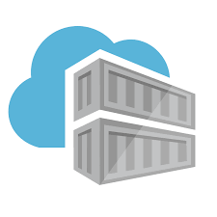
Protect your workloads from threats Use industry’s most extensive threat intelligence to gain deep insights
Detect & block advanced malware and threats for Linux and Windows Servers on any cloud
Protect cloud-native services from threats
Protect data services against malicious attacks
Protect your Azure IoT solutions with near real time monitoring
Azure Security Center
Apps
VMs/
Servers
Containers
SQL
IoT
Network
Management
Cloud workload protection
Microsoft Azure | @Techielass
Notes:
Cloud Workload Protection consists of workload-centric security offerings that target the unique protection requirements of server workloads in modern hybrid, multi-cloud data center architectures. Azure Security Center provides a competitive, cloud-native Cloud Workload Protection Platform (CWPP) for Windows and Linux servers, containers, and serverless workloads that have been widely adopted across Azure and hybrid customers. ASC benefits from the Microsoft Intelligent Security Graph, which uses trillions of signals from Microsoft services and systems around the globe to identify new and evolving threats. ​
​
Here are some capabilities ASC provides for CWPP:​
​
Detect and block advanced malware and threats for servers​
Enable preventive protection, post-breach detection, automated investigation, and response for Windows servers with the integration of Microsoft Defender ATP. You can also enable preventative protection and post-breach detection for Linux servers. Additionally, block malware and other unwanted applications by applying whitelisting recommendations that you adapt to your specific workloads and power through machine learning.​
​
Detect threats across IaaS and PaaS services using advanced analytics ​ Use built-in behavioral analytics and machine learning to identify attacks and zero-day exploits. Monitor networks, machines, and cloud services for known attack patterns and post-breach activity. Focus on the most critical threats first—prioritized security alerts and incidents map different types of alerts into a single attack campaign.​
​
Protect data services against malicious attacks​
Monitor and remediate potential vulnerabilities for databases and storage services in Azure. Detect and respond to potential threats against data services such as suspicious database activities, SQL injection attacks, and anomalous database access and query patterns.​
​
Protect your Azure IoT solution with real time monitoring and analysis of security events ​
Receive alerts to respond to any potential compromises. Define simple threshold-based alerts on data collected from IoT devices and IoT Hub, or define alerts based upon advanced queries across all IoT data (device and hub) as well as relevant ASC data in Azure Log Analytics.​

Slide 27
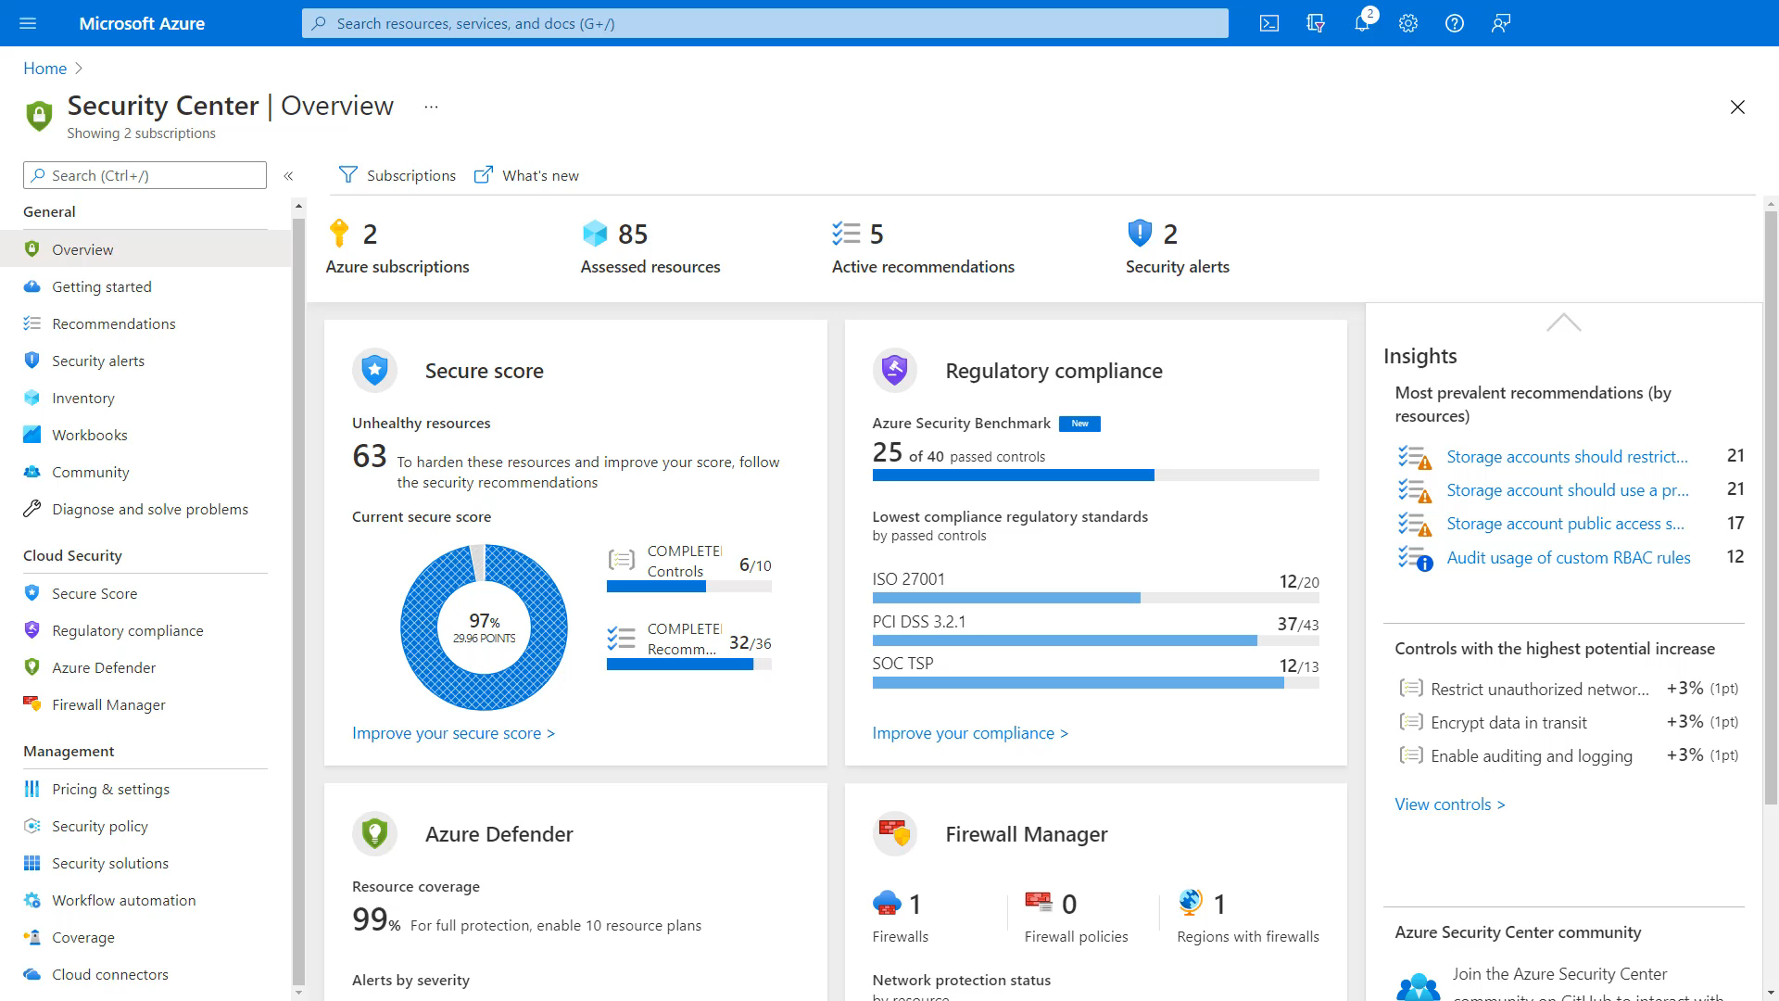

Slide 28

Solutions
Azure Traffic Manager
Windows Admin Center
Azure Arc
Azure Update Management
Azure Security Centre
Microsoft Azure | @Techielass

Slide 29

Thank you! Resources: https://aka.ms/cloudsummit-azure
Sarah Lean
Senior Cloud Advocate
@Techielass
www.techielass.com
Microsoft Azure | @Techielass

